Slide 1
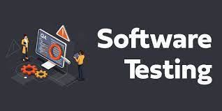
Name: Ruchita chaudhari
Course: Advanced Certification Program in Software Testing
Enrollment no: EBEON0223122606
Batch: 2022-8679

Slide 2
Agenda
What is java
What is Software Testing
Types of software testing
Software Testing Principles
Software Development Life Cycle (SDLC)
Software Testing Life Cycle (STLC)
DBMS and RDMS
Agile Methodology
SQL COMMONDS & Final Project

Slide 3
What is Java?
Java is a programming language and a platform. Java is a high level, robust, object-oriented and secure programming language.
Types of Java Applications
There are mainly 4 types of applications that can be created using Java programming:
Standalone Application
Web Application
Mobile Application
Enterprise Application

Slide 4
What is Software Testing
Software testing is a process of identifying the correctness of software by considering its all attributes (Reliability, Scalability, Portability, Re-usability, Usability) and evaluating the execution of software components to find the software bugs or errors or defects
Software testing provides an independent view and objective of the software and gives surety of fitness of the software. It involves testing of all components under the required services to confirm that whether it is satisfying the specified requirements or not. The process is also providing the client with information about the quality of the software.

Slide 5
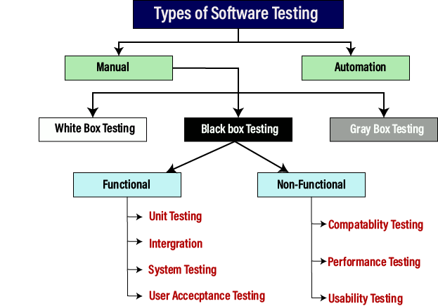

Slide 6
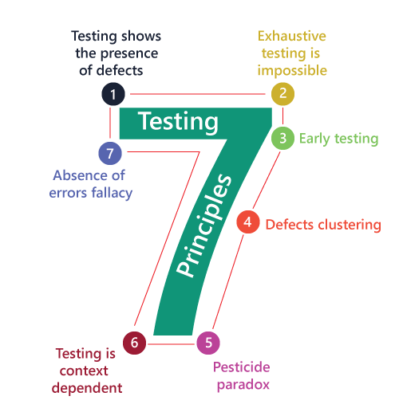
Software Testing Principles
Software testing is a procedure of implementing software or the application to identify the defects or bugs. For testing an application or software, we need to follow some principles to make our product defects free, and that also helps the test engineers to test the software with their effort and time.
The seven essential principles of software testing.

Slide 7
Software Development Life Cycle (SDLC)
SDLC is a process that creates a structure of development of software. There are different phases within SDLC, and each phase has its various activities. It makes the development team able to design, create, and deliver a high-quality product.
SDLC describes various phases of software development and the order of execution of phases. Each phase requires deliverable from the previous phase in a life cycle of software development. Requirements are translated into design, design into development and development into testing; after testing, it is given to the client
Different phases of the software development cycle:

Slide 8
Software Testing Life Cycle (STLC)
The procedure of software testing is also known as STLC (Software Testing Life Cycle) which includes phases of the testing process. The testing process is executed in a well-planned and systematic manner. All activities are done to improve the quality of the software product.
Software testing life cycle contains the following steps:

Slide 9
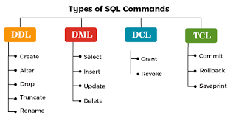
Database Management System(DBMS)
DBMS stands for Database Management System. It is software that allows users to
store, manage, and retrieve data from a database.
A DBMS provides an interface for users to interact with the database, allowing them to create, update, and delete data, as well as perform queries to retrieve specific information.
Relational Database Management System
RDBMS stands for Relational Database Management System. It is a type of database
management system that is based on the relational model.
In an RDBMS, data isorganized into tables, which consist of rows and columns.

Slide 10
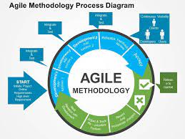
Agile Methodology
Agile methodology is an iterative and collaborative approach to software development that emphasizes flexibility, adaptability, and customer satisfaction.
It promotes continuous iteration and improvement throughout the development process, allowing for faster delivery of high-quality software.
Agile methodology involves the following key roles in a software development project
Product Owner
Scrum Master
Development Team
Stakeholders

Slide 11
Goibibo website our vision is to make travel simple and fun for all
Goibibo is one of India’s leading online travel booking brand providing range of booking choice for hotels, flights, trains, bus and cars for travellers.
Through its mobile app and website, travellers can search, plan and book a wide range of travel services and products in India as well as overseas.
Goibibo’s core value differentiator is its most trusted user experience, be it in terms of quickest search and booking, fastest payments, settlement or refund processes

Slide 12

THANK YOU

